Slide 1
PBT-29FHTC
Patient
Age:
Gender:
Location: pons
Diagnosis: DIPG/DMG H3 K27M
Pre-treatment: no prior treatment
Source: biopsy
Stage: WHO grade IV
Genetic mutations:
H3F3A (p.K28M)
FGFR1 (p.546K)
PIK3CA (p.R93P)
TP53 (p.S127P)

Slide 2
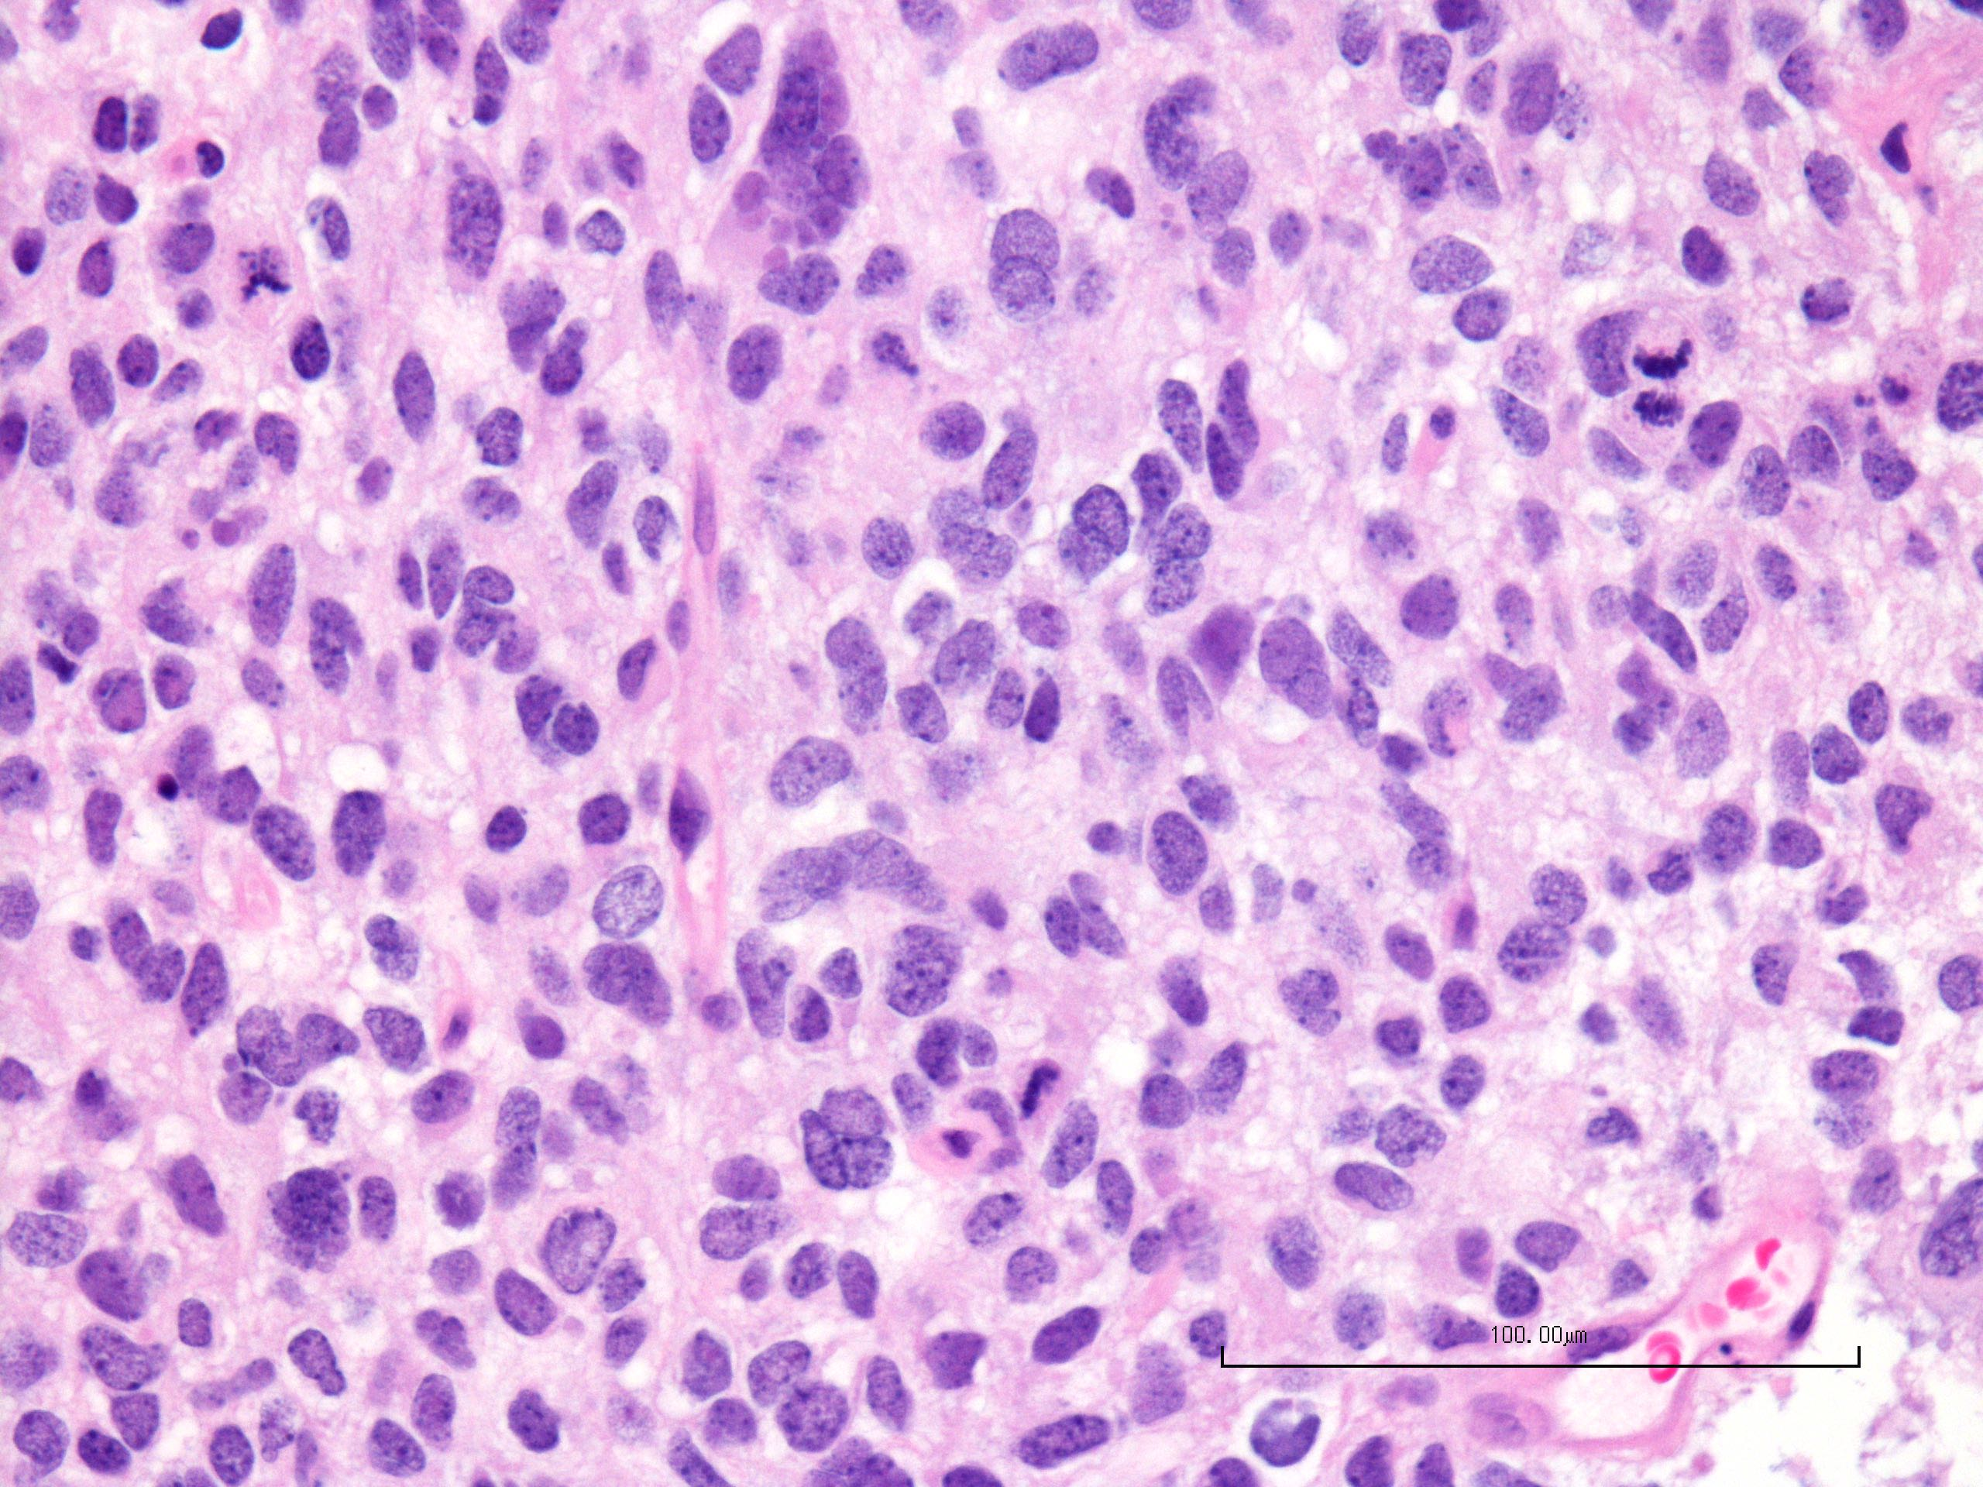
PBT-29FH
H&E staining
Primary Tumor

Slide 3
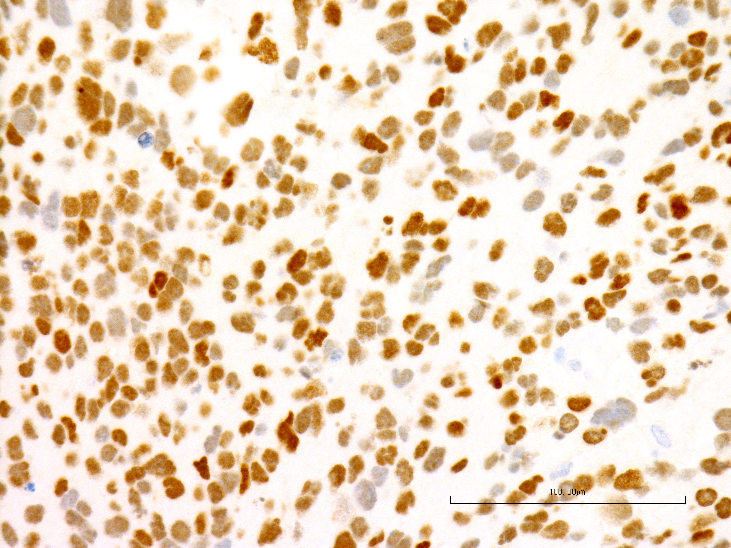
PBT-29FH
H3 K27M Stain
Primary Tumor

Slide 4
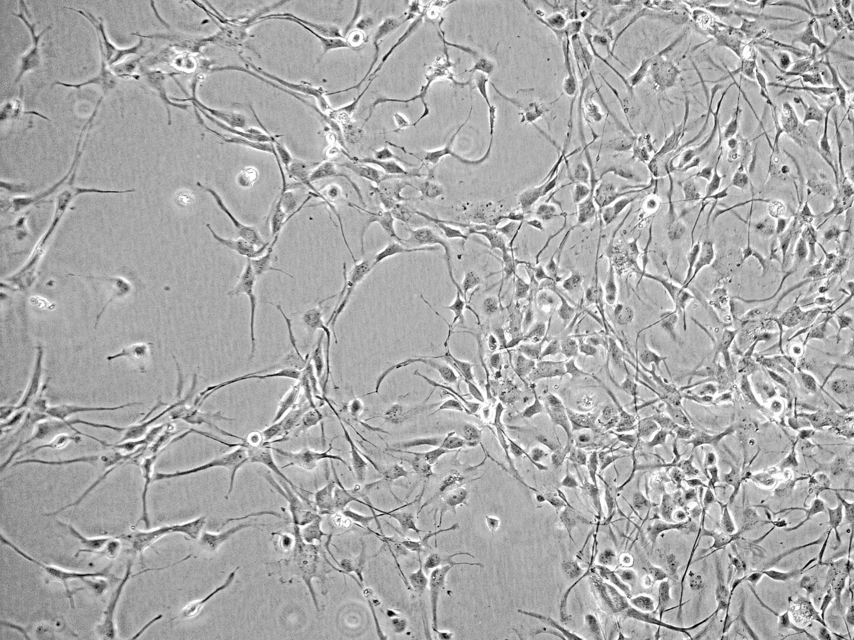
PBT-29FHTC
Laminin coated plastic

