Slide 1
PBT-27FHTC
Patient
Age: 6 yrs
Gender: nd
Location: pons
Diagnosis: DIPG/DMG H3.1 K27M
Pre-treatment: no prior treatment
Source: biopsy
Stage: WHO grade IV
Genetic mutations:
HIST1H3B (p.K28M)
NTRK2 duplication (exons 11-16)
TP53 (p.R27eC with LOH)
loss of portions of Chr. 5, 10, 14, 15, 16

Slide 2
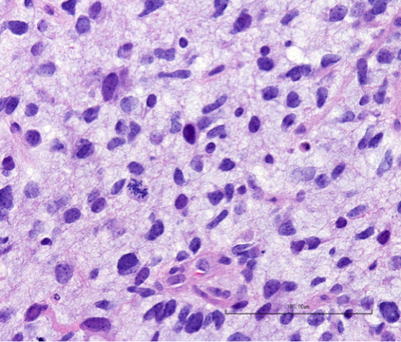
PBT-27FH
H&E staining
Primary Tumor

Slide 3
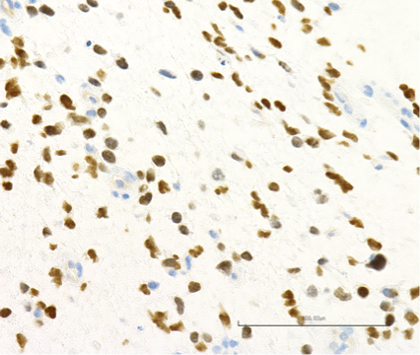
PBT-27FH
H3 K27M Stain
Primary Tumor

Slide 4
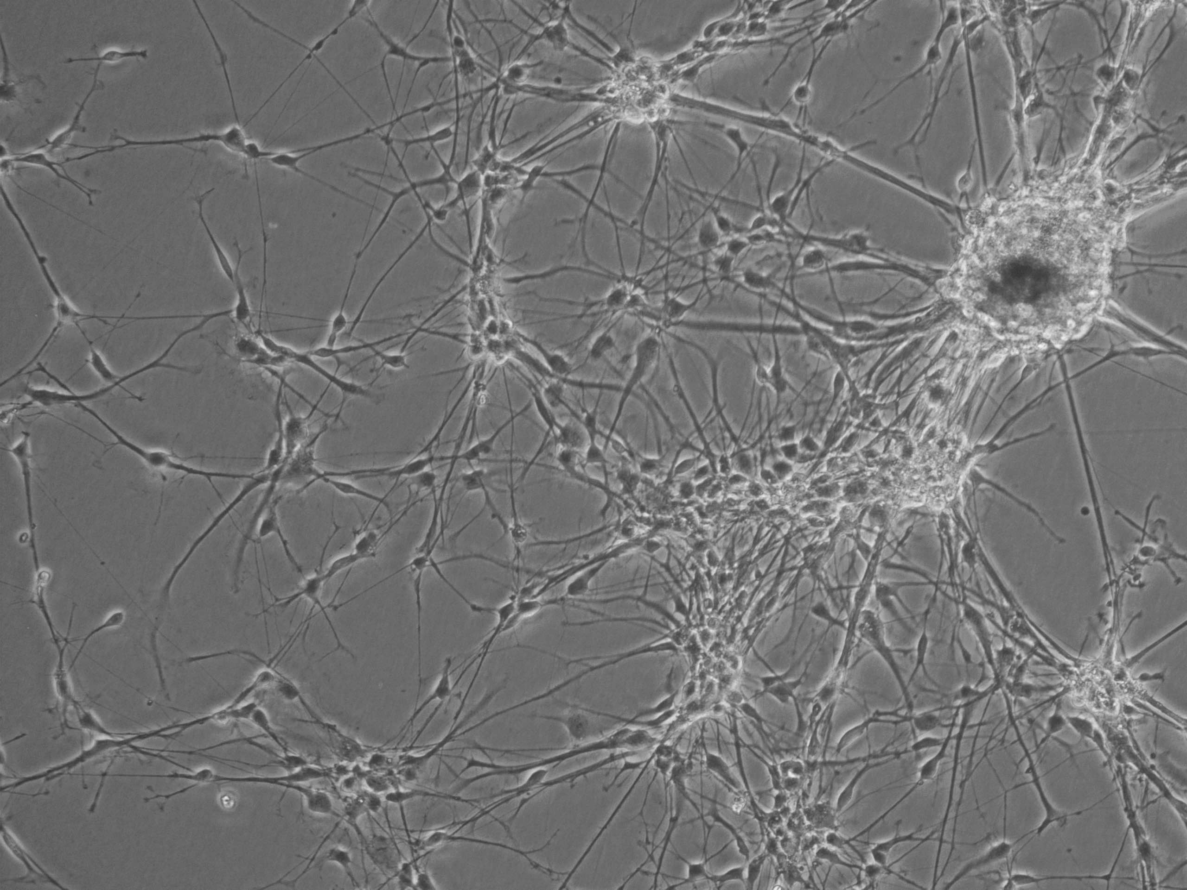
PBT-27FHTC
Tissue Culture
Laminin coated plastic

